Slide 1
Teacher: Mr. Hazzard Contact Email:aaronhazzard2018@gmail.com Subject: Information Technology Topic: Fundamentals of Hardware & Software Sub-Topic: User Interface & Computer Terms.

Slide 2
Lesson Objectives:
Explain the terms: Multitasking, Multiprocessing and Multiprogramming.
Define processing?
Explain the different types of processing modes.
Distinguish between types of user interface.

Slide 3
Define processing?
Processing is the manipulation of data to produce information.

Slide 4
Different processing mode:
Batch Processing
Real-time
On-line

Slide 5
processing mode
Batch Processing: is the processing of a number of jobs/task simultaneously from the start to finish without user intervention.
Examples of Batch Processing are:
Processing Hand-written receipts
Inventory Control
Accounts receivable where invoices are hand-written.

Slide 6
processing mode
On-line Processing: this is a transaction that is completed or perform over the internet which is not efficient as batch processing.
Examples of On-line are:
ATMs
Point of Sale

Slide 7
processing mode
Real Time: a processing mode in which the passage of real-time is critical to the application.

Slide 8
Definition for User Interface?
User Interface can be define as the link between the user and the computer.

Slide 9
Types of User Interface
Command-Line Interface
Graphical User Interface
Menus:
Pull-down Menus
Pop-up Menus
Touch Screens
Braille Keyboards
Sensors

Slide 10
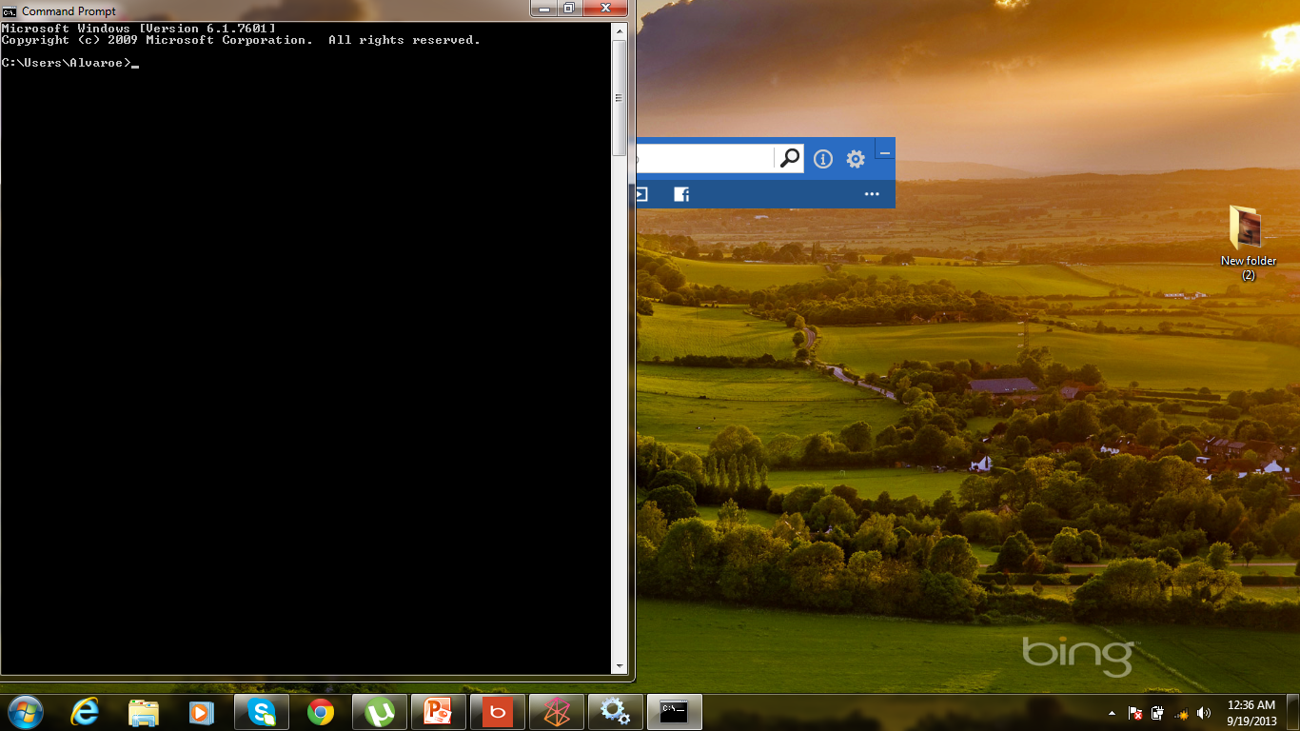
Define Command-Line
Command-line: this interface does not have the fancy buttons or graphic found in Graphical User Interface.

Slide 11
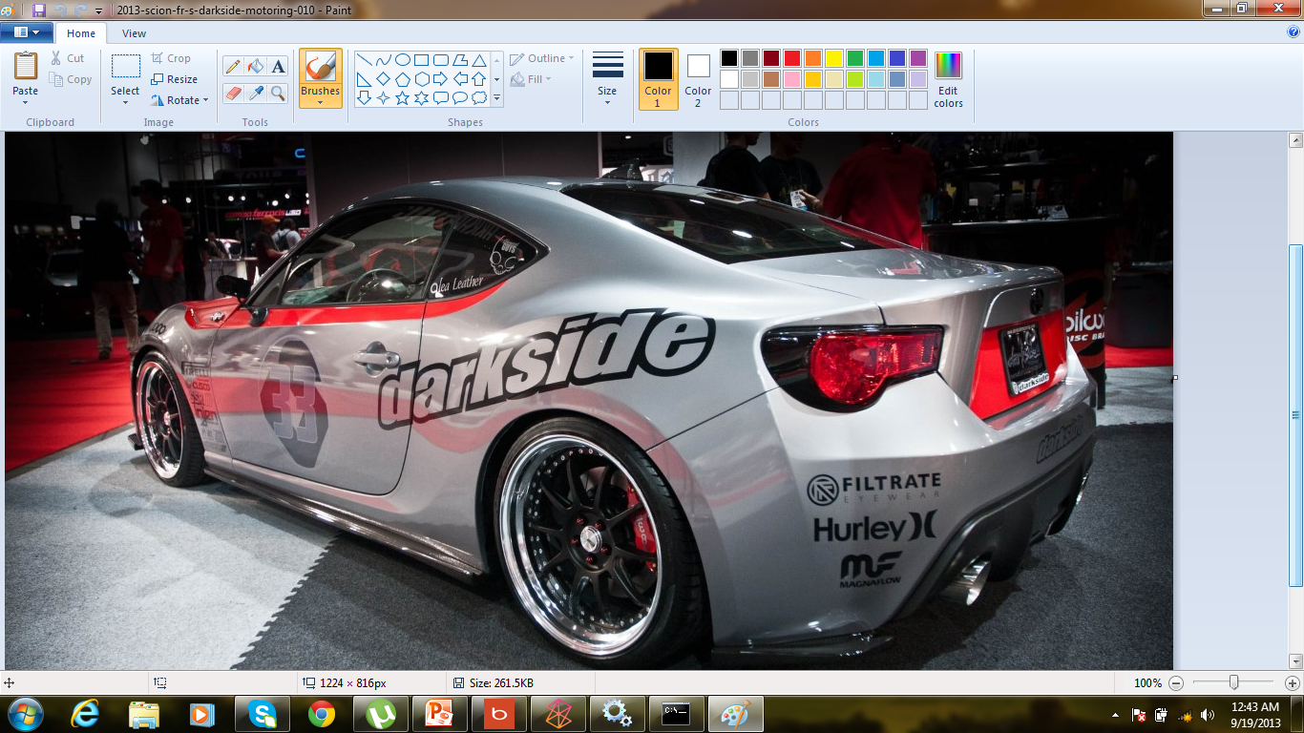
Define Graphical User Interface
Graphical User Interface (GUI): display the various commands and options using icons, menus and buttons.

Slide 12
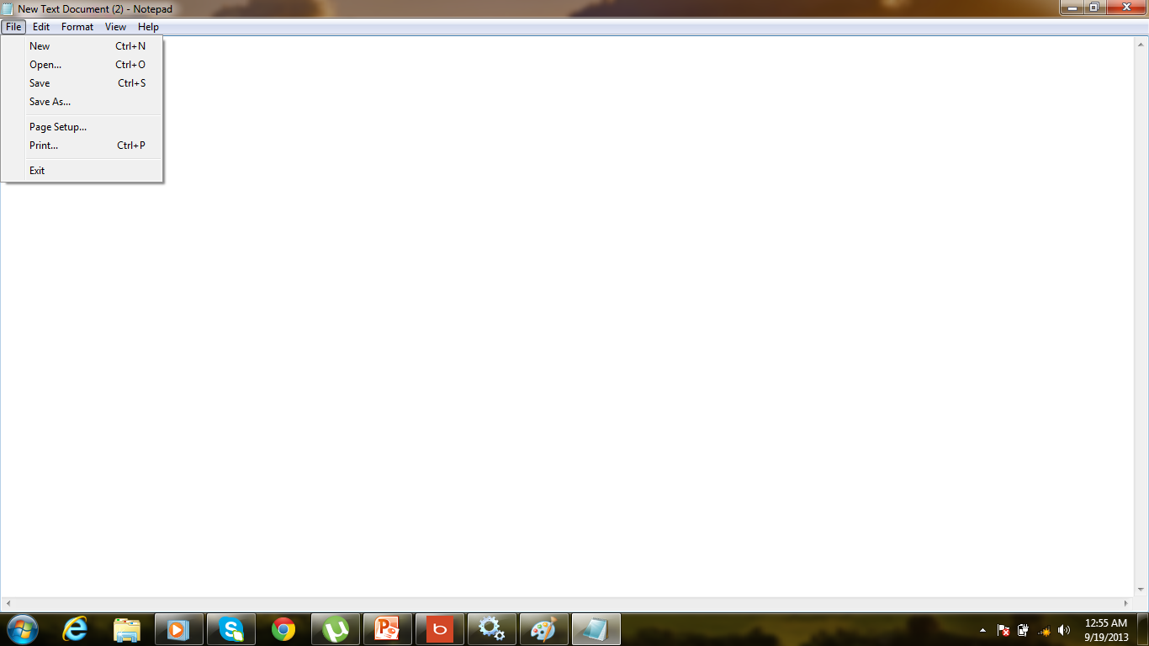
PULL-DOWN MEMUS

Slide 13
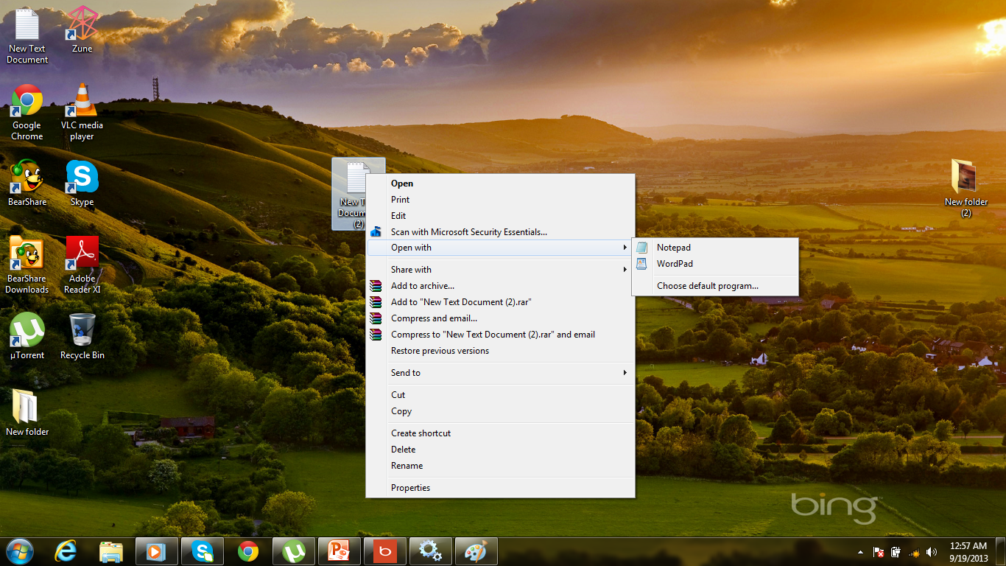
Pop-Up MEMUS

Slide 14
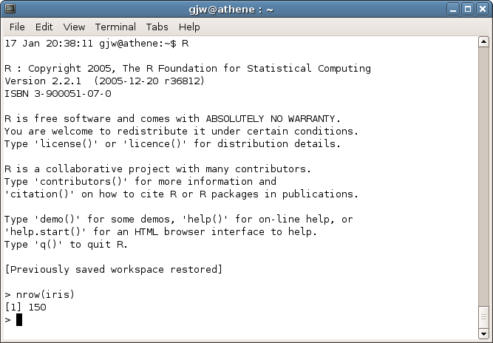
COMMAND DRIVEN INTERFACE

Slide 15
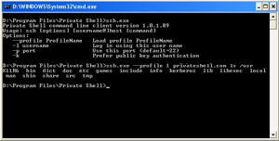
COMMAND DRIVEN INTERFACE2

Slide 16
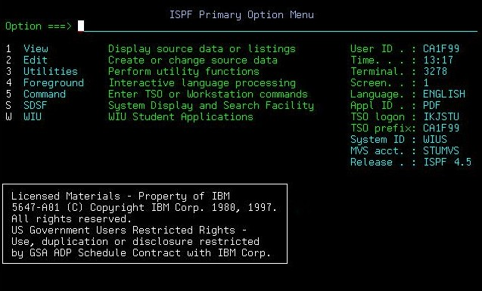
MENU DRIVEN INTERFACE

Slide 17
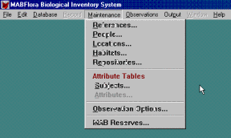
MENU DRIVEN INTERFACE2

Slide 18
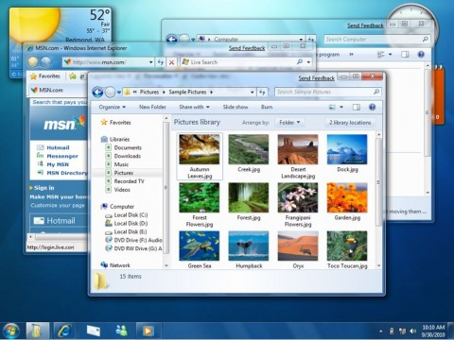
GUI

